Slide 1
What’s Our Biggest Problem?

Slide 2
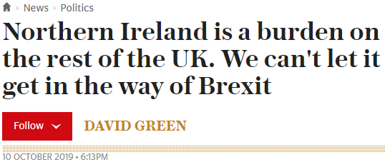
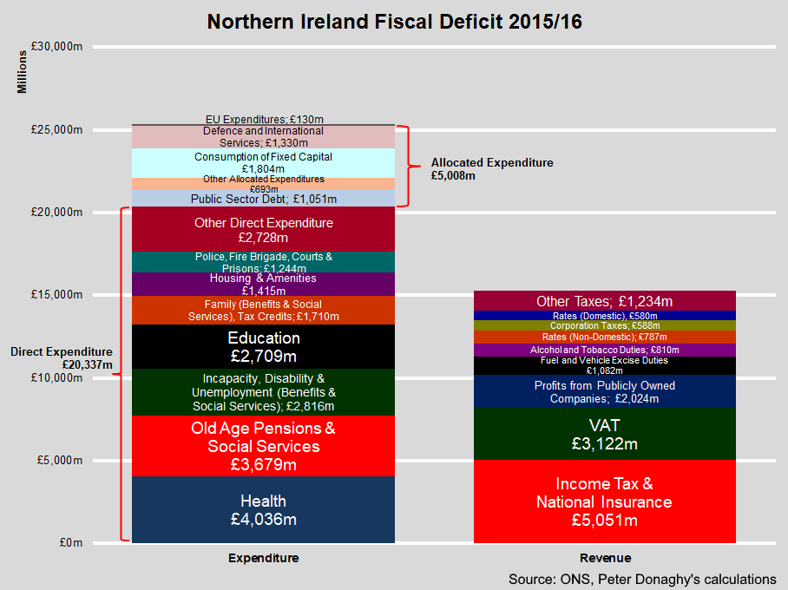
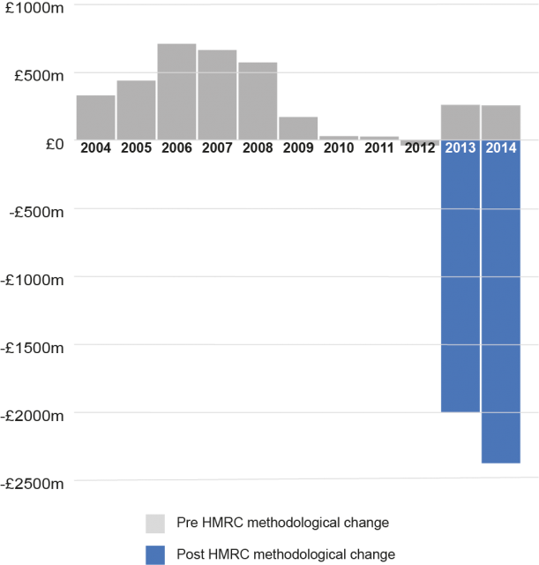
We spend more than we earn
Spending vs Taxes
Exports - Imports (EU)

Slide 3

How do we fix this?
We need a world leading business monopoly

Slide 4
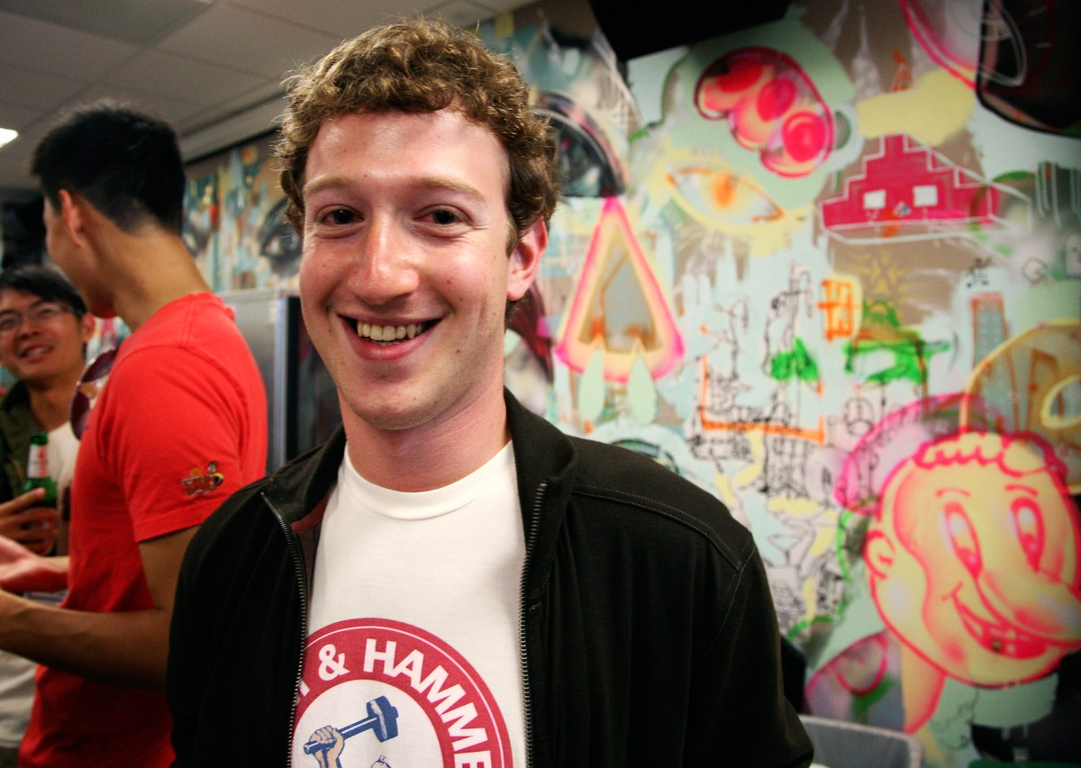
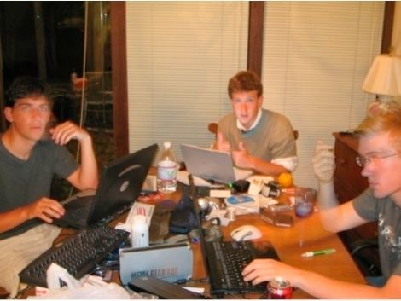
How do we get one of those?
We need a few Zuckerbergs

Slide 5
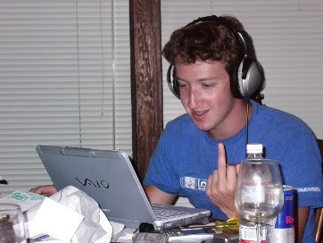
What can Zuckerbergs do?
Have energy and focus
Can solve any problem, regardless of experience, efficiently
Can identify useful objectives without a boss
Can build teams and motivate others

Slide 6
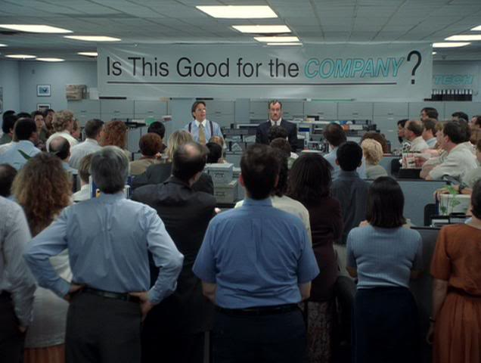
We don’t teach this
We teach people to be employees

Slide 7
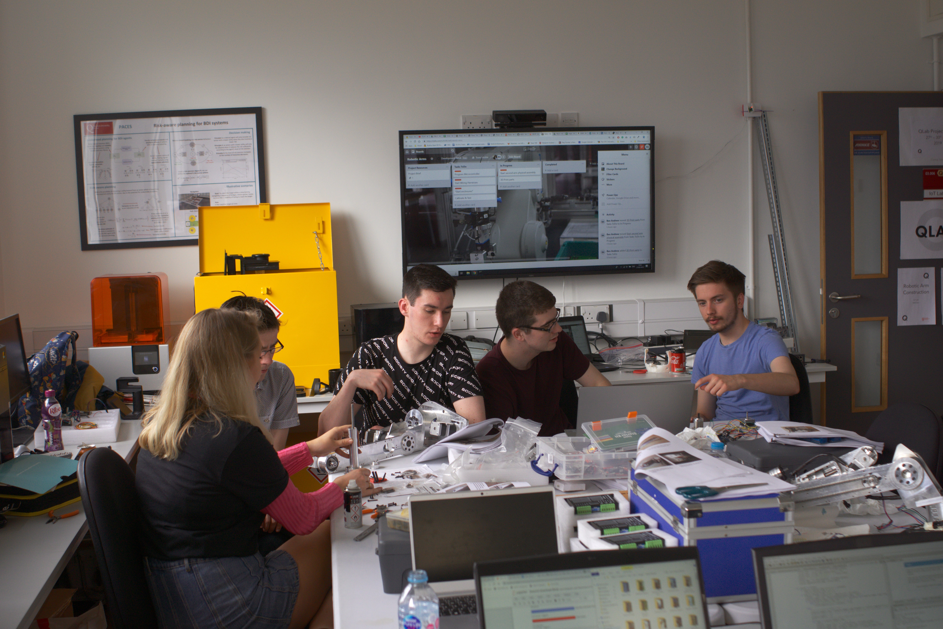

Let’s change that

Slide 8
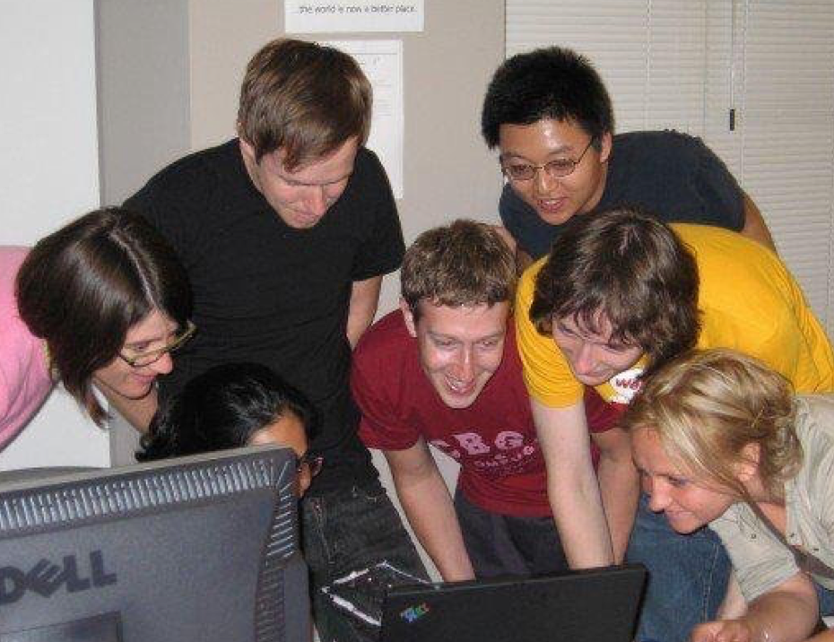
New 1st Year Module:
Comp. Sci. Challenges
Personalised intensive coaching
No teaching, lectures or labs: Students get marks for working it out themselves
Marks for increasing their energy and focus
Students get marks for finding a better objective than the one set by the lecturer
Judged on making something useful not whether they do what they are told

Slide 9
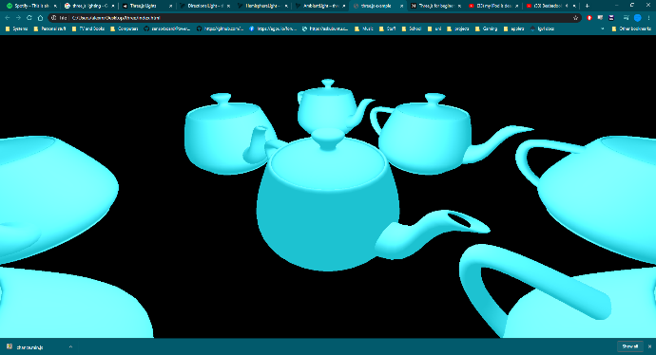
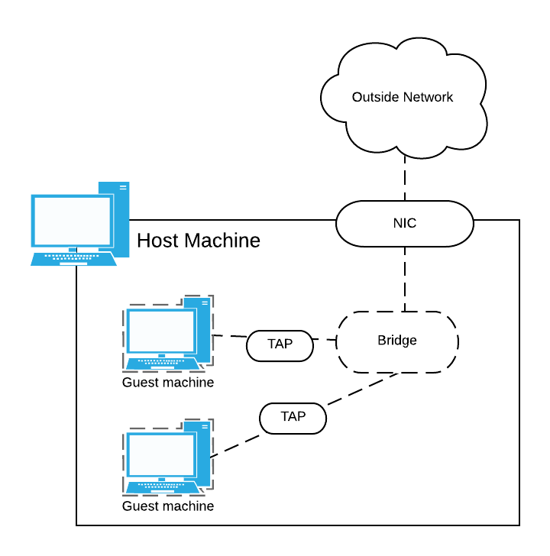
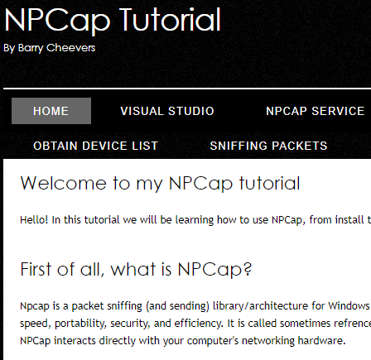
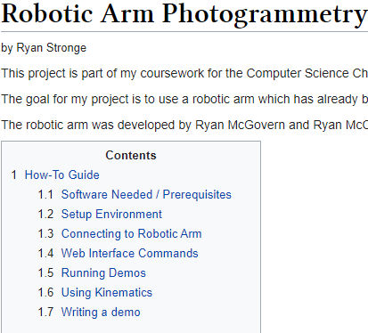
3 Weeks of dev work later
Students have self taught post-grad/PhD level technology
Students have produced results that can actually be used by others to solve real problems
Many on track to create MEng-level final year projects in half the time

Slide 10
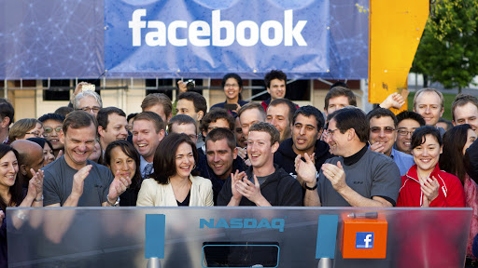
Future Modules
Have energy and focus
Can solve any problem, regardless of experience, efficiently
Can identify useful objectives without a boss
Can build teams and motivate others

Slide 11
Help us make this happen
Join Qlab
Participate in our 5 Day Development week Hackathons 25th-29th May
Join us during our summer internships (All Summer)
Convince the university to let us make an entrepreneurship module ☺
Email j.bustard@qub.ac.uk

